Slide 1
Frequency/ FOURIER domain / SPECTRA
Aug 8, 2017 Dinesh Babu J

Slide 2
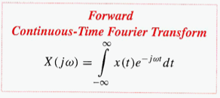
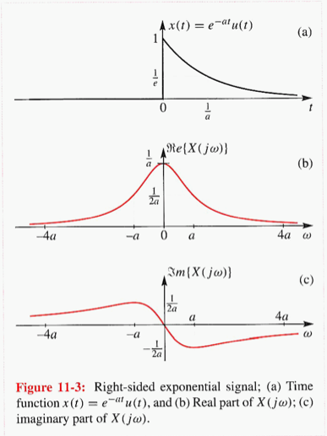
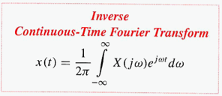
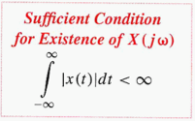

Fourier Transform
Not necessary

Slide 3

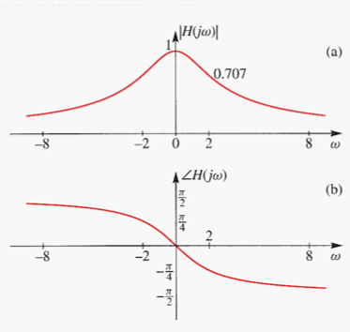
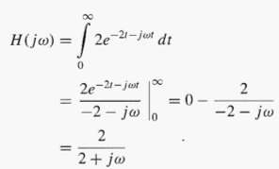

Sample problem 1: Compute CFT
CFT of

Slide 4
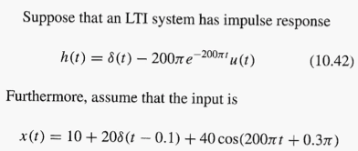



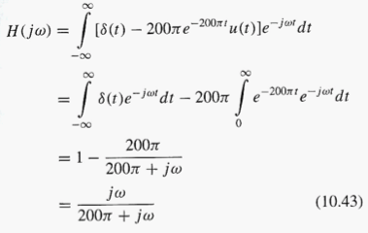
Problem 2: Compute LTI Output
EASIER IN
FREQUENCY DOMAIN
THAN
TIME DOMAIN

Slide 5
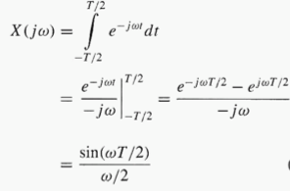
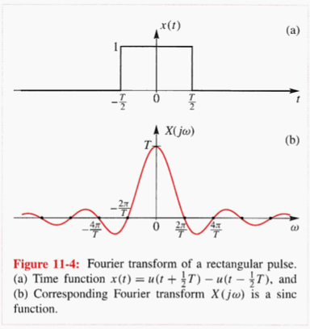
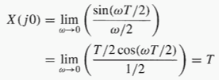
Fourier Transform: Time Limited

Slide 6
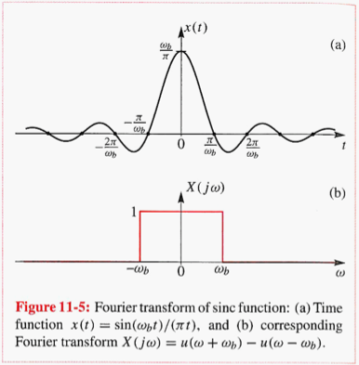
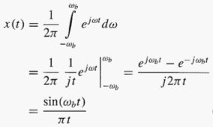

Fourier Transform: Band limited

Slide 7
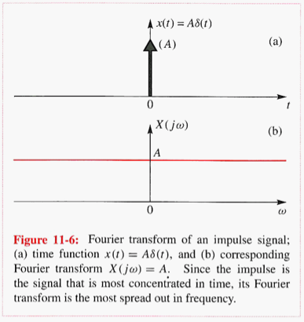
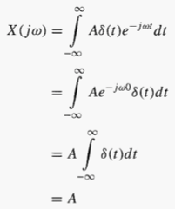


Fourier Transform: Impulse in time

Slide 8
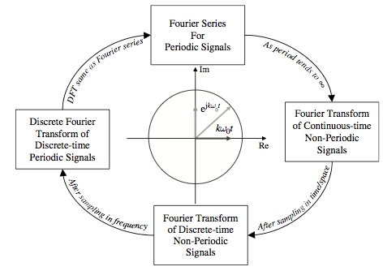
Fourier domain

Slide 9

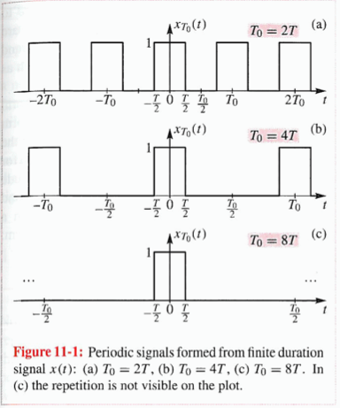
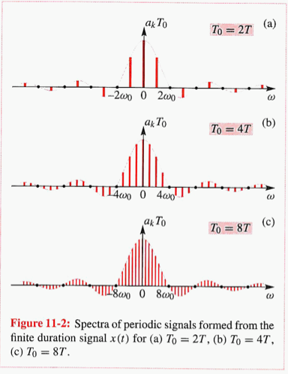
Fourier Series to Fourier Transform

Slide 10
Overview

Slide 11
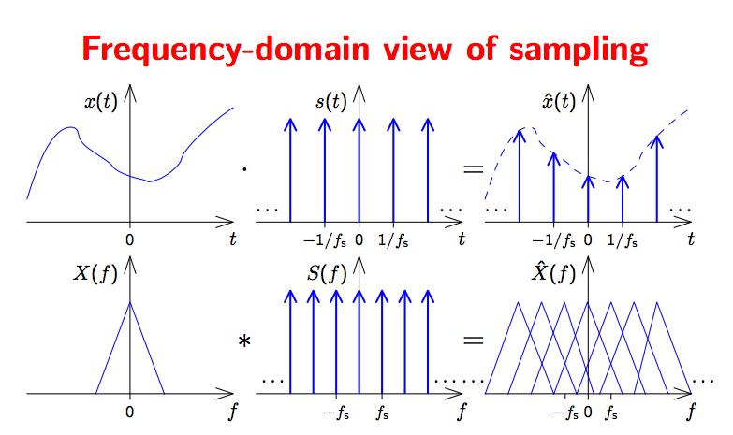
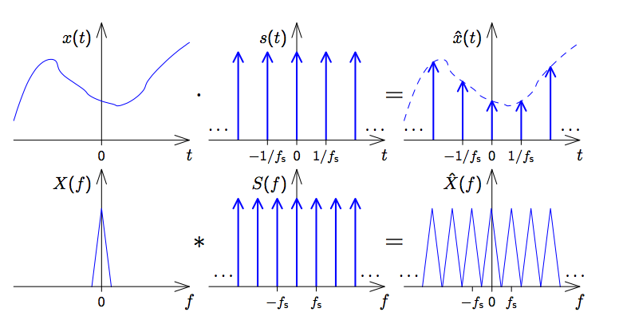

Slide 12
Overview

Slide 13
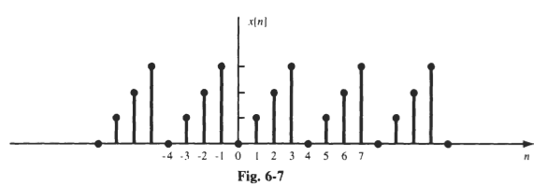

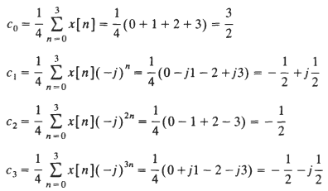


Compute Spectra: DTFS

Slide 14
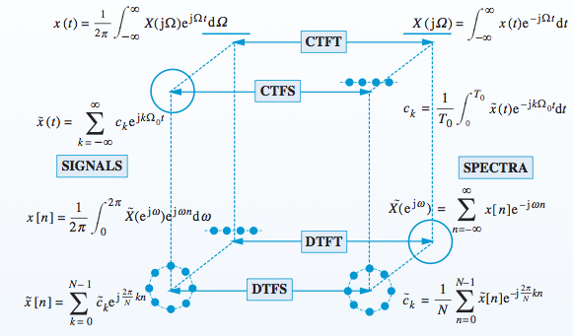
Spectra
1. Continuous, Discrete – signal
2. Periodic, Aperiodic - signal

Slide 15



Relation between DTFS and DFT
DFT

Slide 16

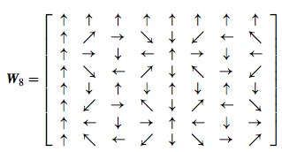
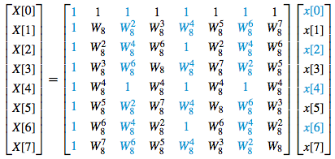
Discrete Fourier Transform to Fast Fourier Transform

